Slide 1

Data Lake Strategy via Data Mesh Architecture 2021
James Reid, CIO, Employee Experience and Corporate Technology (EECT)
Arup Nanda, Global Head of Architecture, Enterprise Data
Sarita Bakst, MD, Chief Information Architecture for Firmwide Data Management

Slide 2
Why Data Lake via Data Mesh Architecture?
Unlocking the Opportunity and Business Value in our Data
Democratize the “Data”
Take advantage of big data by maximizing availability and accessibility for analytics
Achieve a balanced business-technology outcome that displays measurable benefits
Three major principles to drive the cloud data lake strategy
Modernize Our Platform
Move Beyond a Monolithic Data Lake
Build a Loosely Coupled Architecture for Data
Aggregate Fit-for-Purpose Data Products
Distributed Pipelines
Cost Savings
Business Value
Data Reuse
Identifying use cases where possible to reduce infrastructure cost while still providing business value and data reuse
Identify use cases that will can unlock business value through removing pain points or creating new opportunity
Align our use cases with associated data domains to identify and maximize data reuse, ownership, and central governance
Cost Savings
Business Value
Data Reuse
1
2
3
Use Cases & Timing
Reusable Data Domains (Ponds)
Labor & Infra. Cost Savings
Alleviate Pain Points
Diverse Data Lake

Slide 3



Modernize Data Platform on Public Cloud
Source
Consumption
Ingestion Services
Orchestration
Meta Data Management
Data Catalog
Telemetry
Security
Data Federation
Source
Relational Databases
Data Infrastructure as a Platform
Ops
Reporting
DBA
Data
Analyst
Product 1
Product 2
Product 3
Hadoop Clusters
E
T
L
Analytics
ML / AI
E
T
L
E
T
L
Data
Engineer
Data
Scientist
Hybrid Lake Consumption
Product 4
Product 5
Files
E
T
L
E
T
L
Data Access
On-Premise
Data Lake
Engine
Data Lake
APIs
Loosely Coupled Domains
Decoupled Compute/Storage
Elasticity
Data as Products
Key Principles
Data as Products – “Product Thinking”
Identify Data Domains
Stop the proliferation of data puddles on-premise
Move data puddles to data ponds and move data ponds to data lakes
Data as Products
End to End Ownership – “You build it, You own it, You Run it”
Data Democratization – “Liberate Your Data”
Domain Driven Distributed Architecture
Self-Service Infrastructure as a Platform
Ecosystem Governance
Data Catalog
Meta Data Driven
Data Lineage
Adjustments / Reconciliation

Slide 4
Data “Product Thinking” - Data as Products
Guiding Principles
Establish and align on common taxonomy and terminology (data pond, data lake, data domains, etc.)
Apply domain driven design techniques to formulate and establish bounded contexts for data products
Balance between coarse and fine-grained bounded contexts – “roughly right data products”
Align consumption use cases (workloads) with data products to plan and execute delivery of data products on the data lake
Identify opportunities of reuse of data products based on consumption use cases
Performance considerations may drive tradeoffs to loosen bounded context
Learn by doing and evolve!
Bounded Context
Bounded Context
Wholesale Credit Risk
General Reference Data
Credit Exposure
Country
Bounded Context
Credit Grading
Credit Facility
Currency
Geography
Party
Products & Services
Party
Business Unit
KYC Customer

Slide 5









Data as Products
What are Data Products?
Data Products
Broad, cohesive collections of related data aligned to business functions and goals, and which are potentially made up from multiple contributors
Not bound by technology asset structures
Data Product Ownership
Each Data Product will have a single Data Product Owner
Data Product Owner is responsible for the governance of Data created, provided, stored, transformed in, or consumed from their Data Product
Data Product Owner will identify a Technical owner to be responsible for the Lake Account
Data Sub-products
Data Sub-products are granular, specific collections of Data within a Data Product
Data Product Owner may delegate responsibilities for Sub-Products within their Data Product
Data Mesh
A Data Mesh is a framework by which multiple Data Products can be used together
A Data Mesh is comprised of Data Products, contributors and consumers
Data Mesh
Data Product
Data Product
Owners
Wholesale Credit Risk
T & P
Owners
Consumer / Contributor
Credit Exposure
Cash
Data Sub
Products
Data Product
Derivatives
Data Sub
Products
Securities
Credit Grading
Credit Facility
Party
Collateral
Party
Data Sub
Products
Contributor
Business Unit
KYC Customer
Consumer
Owners

Slide 6



Data Product Responsibilities
What are the Data Product Owners’ Responsibilities?
Data Product Owner
Represents the business and aligns their technology counterparts on business requirements, including data product risk mitigation, classification, entitlements and overall quality of the data
Delegate to sub-owners who are responsible for domains of data within the product
Collaborates with the Technical Owner to provide approvals for contributors to the Data Product and review any Local Copy
Technical Owner
Responsible for operationalizing the Data Product and facilitating collaboration with contributing applications
Owns the Lake Account
Ensures technical data quality and makes sure that Local Copies are approved and intact
Data Mesh
Data Product
Data Product
Owners
Wholesale Credit Risk
T & P
Owners
Consumer/Contributor
Credit Exposure
Cash
Data Sub
Products
Data Product
Derivatives
Data Sub
Products
Securities
Credit Grading
Credit Facility
Party
Collateral
Party
Data Sub
Products
Contributor
Business Unit
KYC Customer
Consumer
Owners

Slide 7






Data Product Responsibilities
What are the responsibilities for different stakeholders?
Contributor
Applications that hydrate into a specific Data Product that is associated with a Lake Account
Consumer
Applications that utilize the Data Mesh to locate and request Data from Data Product specific Lake Accounts
CDO Group
Identifies and creates new Data Products / Sub-products and assigns Data Product Owners in partnership with Tower Information Architects and CT IA
Assigns a CDO Lead to each Data Product
Considers all requests for additions / changes to Data Products
Data Mesh
Data Product
Data Product
Owners
Wholesale Credit Risk
T & P
Owners
Consumer/Contributor
Credit Exposure
Cash
Data Sub
Products
Data Product
Derivatives
Data Sub
Products
Securities
Credit Grading
Credit Facility
Party
Collateral
Party
Data Sub
Products
Contributor
Business Unit
KYC Customer
Consumer
Owners
Owners

Slide 8
Let’s Talk about Technology
Key Challenges
Producer Questions
How can I write data into various datastores?
How can I move data from one store to the other?
How can I easily transform or produce a presentation layer?
Consumer Questions
Where is my data?
Can I trust this data?
Where did it come from?
Who all are using it?
Who can grant me access to this data?
How can I access it seamlessly?

Slide 9
Data Mesh Architecture: Key Technical Components & Capabilities
All the information from Inventory, DQ and Lineage are presented in the Marketplace where customers come to look for the data of their interest. This creates the “trust” in the data.
Data Inventory
Schema Inferrer
Database 1
Producer
Data Ingestor
Router
Database 1
Producer
Producer
Data Quality Checker
Lineage Tracker
Database 1
Data Marketplace
We use an internal marketplace UI

Slide 10
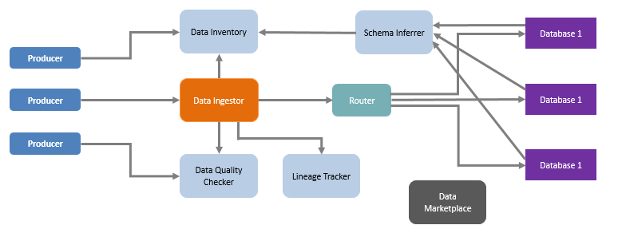
What about Customers?
How will customers get the data from these systems?
Key Questions
How will they find the data?
Who will be allowed to access what? Entitlements
How they will get the data? Through what mechanism?
How can they trust the data?

Slide 11
Data Mesh Architecture: Consumption of Data
Different systems require different ways to get data. SQL is typically supported everywhere; so a single SQL interface tool that can translate SQL statements specific to the datastore. For application access, GraphQL is a preferred approach as it abstracts the data and metadata.
SQL
Database 1
Consumer
Consumer
Database 1
GraphQL
Consumer
Database 1
Central Entitlement System
Corporate Identity Systems
For entitlements, we use AWS Lake Formation and Glue Catalog for Table Objects and an internal system for non-Table. For SQL, we use Athena and Redshift Spectrum.

Slide 12






















Data Mesh Architecture: AWS Technical Architecture Diagram
Data Mesh Architecture: AWS Technical Architecture Diagram
AWS Cloud
Streaming Layer
Amazon Kinesis
Ops/Self - Service
Ingestion
Platform Components
Authorization
Data Lake
Entitlements
Raw
Trusted
Refined
Operations
Bucket Policy
(Validate)
(Transformed)
(Adjustments)
AWS IAM
Metadata Layer
Lake Formation
Data Catalog Registration
Processing Layer
Consumption Layer
AWS KMS
Amazon
Redshift
Spectrum
Jupyter
Glue Catalog
Notebook
AWS Certificate Manager
EMR Cluster
Amazon
Athena
SageMaker
Data Lineage & Traceability
Workflow Layer
Orchestration
Glue Crawler
AWS System Manager
Glue ETL job
BI/ Reporting
ML/AI
Telemetry
Logs
Lambda

Slide 13
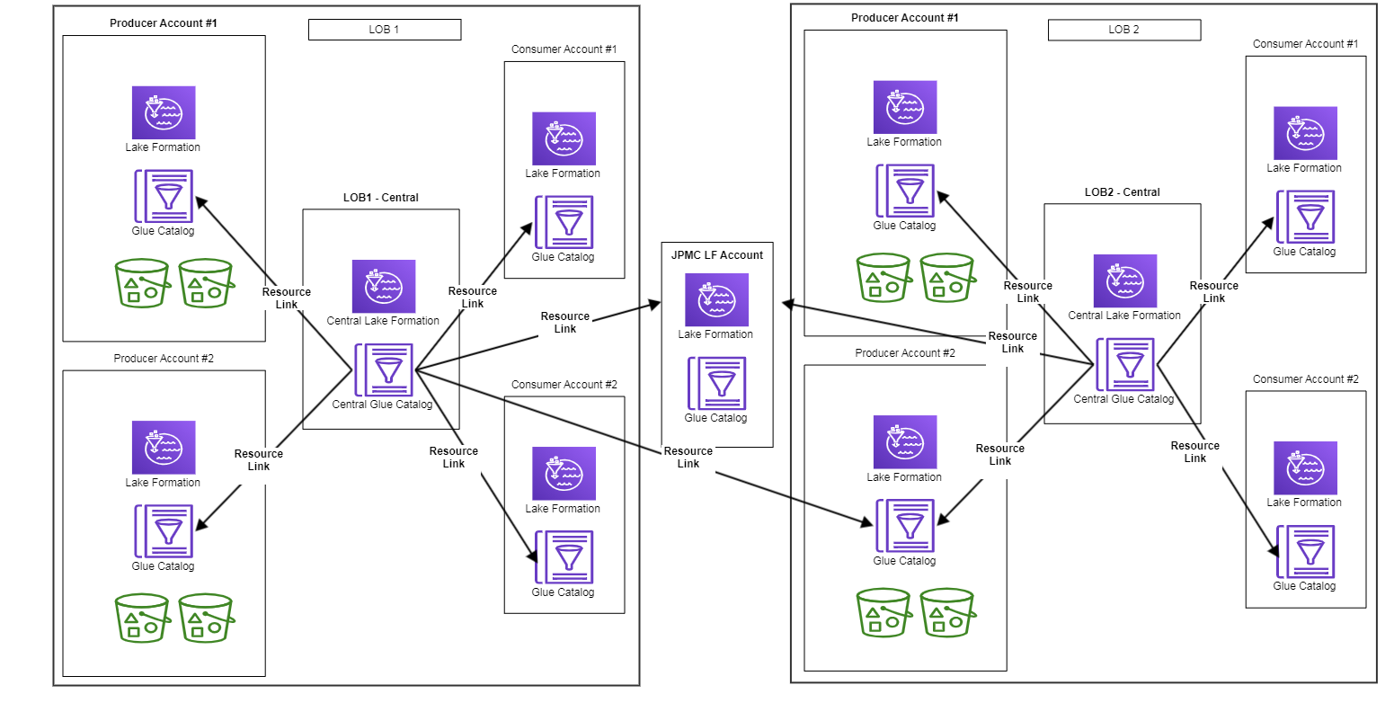
Lake Formation in Data Mesh World
Each LOB owns its respective central LF account
Allows them to control entitlements, audits and present data as appropriate
The central JPMC account is a superset of all catalogs, where a user can look up data they are looking for.
It does not allow granting or revoking access to any dataset

Slide 14


Recapping the Solutions
Ingestor
Revisiting the Challenges and the Solutions
Producer Questions
How can I write data into various datastores?
How can I move data from one store to the other?
How can I easily transform or produce a presentation layer?
Catalog
Consumer Questions
Where is my data?
Can I trust this data?
Where did it come from?
Who all are using it?
Who can grant me access to this data?
How can I access it seamlessly?
Lineage
Data Quality
Entitlement System
Lineage
GraphQL

Slide 15


